Slide 1
Object Oriented Programming using Java (ECSE102L)

Slide 2
Outline
Examples of Method
Initializing an Object through Constructor

Slide 3
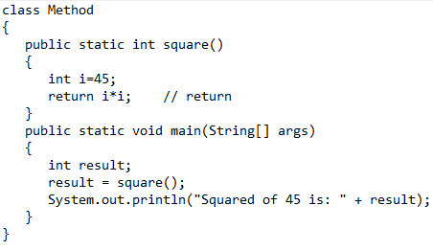
Examples of Method
S
Return from Method

Slide 4
Examples of Method (Cont…)
S
Return from Method (Cont…)
  Output
      Squared of 45 is: 2025

Slide 5
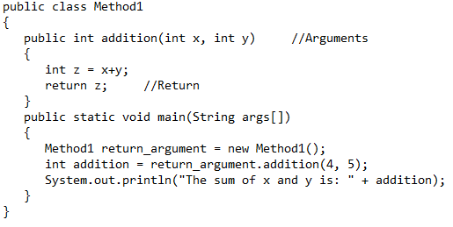
Examples of Method (Cont…)
S
Return with Arguments

Slide 6
Examples of Method (Cont…)
S
Return with Arguments (Cont…)
  Output
      The sum of x and y is: 9

Slide 7
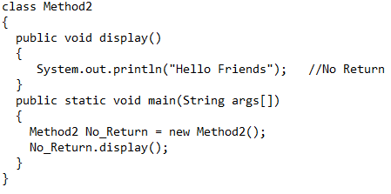
Examples of Method (Cont…)
S
No Return from Method

Slide 8
Examples of Method (Cont…)
S
No Return from Method (Cont…)
  Output
      Hello Friends

Slide 9
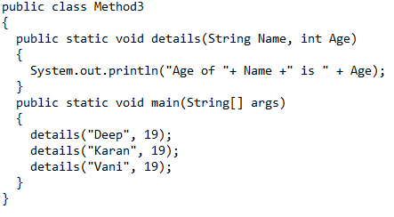
Examples of Method (Cont…)
S
No Return with Arguments

Slide 10
Examples of Method (Cont…)
S
No Return with Arguments (Cont…)
  Output
      Age of Deep is 19
      Age of Karan is 19
      Age of Vani is 19

Slide 11
Examples of Method (Cont…)
S
Static Method
  If we apply static keyword with any method, it is known as static method.
  A static method belongs to the class rather than the object of a class.
  A static method can be invoked without the need for creating an instance of a class.
  A static method can only access static data member and can change the value of it.
  “this” and “super” cannot be used in static context.

Slide 12
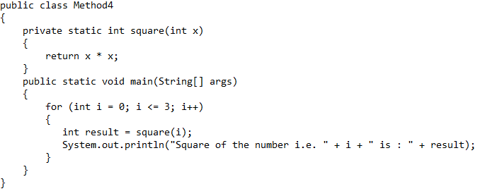
Examples of Method (Cont…)
S

Slide 13
Examples of Method (Cont…)
S
Output
      Square of the number i.e. 0 is : 0
      Square of the number i.e. 1 is : 1
      Square of the number i.e. 2 is : 4
      Square of the number i.e. 3 is : 9

Slide 14
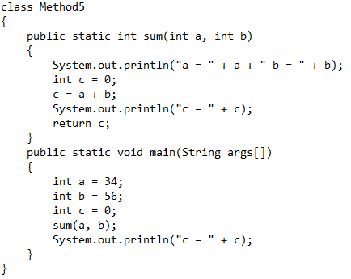
Examples of Method (Cont…)
S

Slide 15
Examples of Method (Cont…)
S
Output
      a = 34 b = 56
      c = 90
      c = 0

Slide 16
Initialization Through Constructor
S
Every class has a constructor.
If we don’t define a constructor in a class, compiler builds a default constructor.
Constructor is used to initialize any object.
The name of the constructor is the same name as the class.
A class can have many constructor.
It does not have return type.

Slide 17
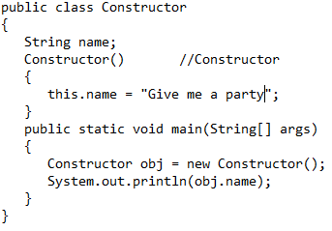
Initialization Through Constructor (Cont…)
S
Here, we have shown the instance variable name of the object.
Output is what we passed to the name during initialization in constructor.
When the object is created, the constructor is invoked.
“this” is a keyword that points to the current object.
17

Slide 18
Initialization Through Constructor (Cont…)
S
There are three types of constructor:
  Default: If we do not implement any constructor in a class, compiler uses a default constructor.
  No argument: It is a constructor with no arguments.
  Parameterized: This type of constructor has parameters or arguments.

Slide 19
Initialization Through Constructor (Cont…)
S
Default Constructor
class Constructor
{
public static void main (String args[])
{
Constructor obj=new Constructor()
}
}
class Constructor
{
Constructor()
{
}
public static void main (String args[])
{
Constructor obj=new Constructor()
}
}
19

Slide 20
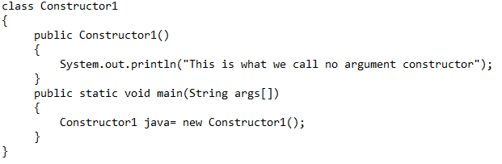
Initialization Through Constructor (Cont…)
S
No argument constructor

Slide 21
Initialization Through Constructor (Cont…)
S
No argument constructor (Cont…)
  Output
    This is what we call no argument constructor

Slide 22
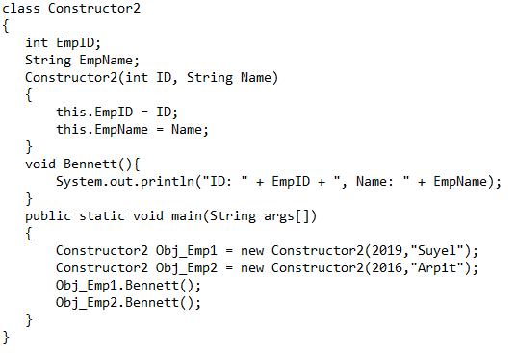
Initialization Through Constructor (Cont…)
S
Parameterized Constructor

Slide 23
Initialization Through Constructor (Cont…)
S
Parameterized Constructor (Cont…)
  Output
    ID: 2019, Name: Suyel
    ID: 2016, Name: Arpit

Slide 24
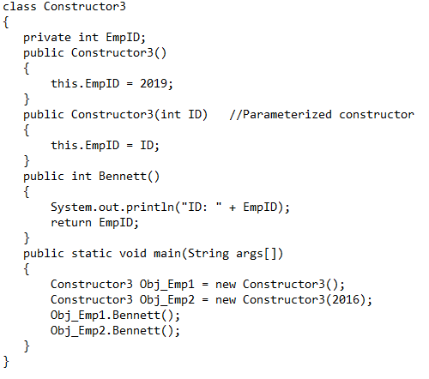
Initialization Through Constructor (Cont…)
S

Slide 25
Initialization Through Constructor (Cont…)
S
  Output
    ID: 2019
    ID: 2016

Slide 26
Comparisons between Constructor and Method
S
Constructor | Method
Constructor is used to initialize an object. | Method is used to define functionality of an object.
Constructors are invoked implicitly. | Methods are invoked explicitly.
If constructor is not present, a default constructor is invoked by the compiler. | Here, no default method is invoked.
Constructor does not return any value. | Method may/may not return a value.
Constructor must have the same name as the class. | Method must not have the same name as the class.

Slide 27




